Slide 1
I don’t even do Data Science
Albert, Ethan, Daniil

Slide 2

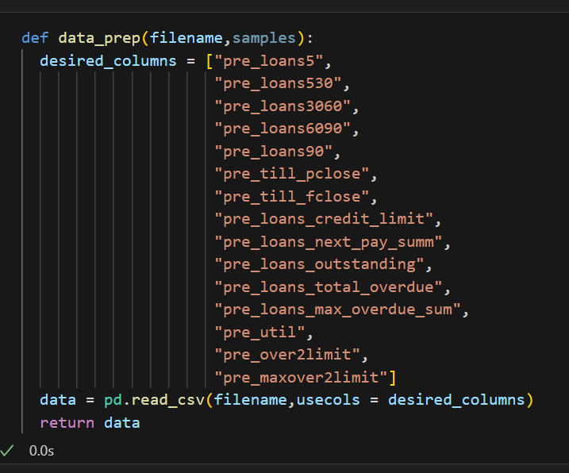
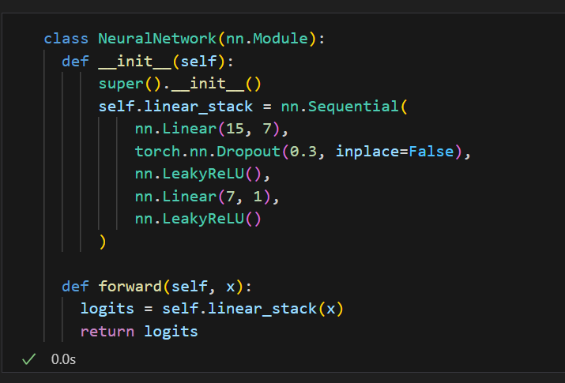
Our Methodology
Due to the size and complexity of the data we had are working with we decided to use pytorch to develop a MLA in order to create a prediction model.
To start we decided to look at only 15 of the columns/ input variable of the dataframe in each file. We chose these specific 15 based upon avoiding repetition and redundancies
From our starting 15 input we first cut down to around half and then down to the single output variable we desired.
The simplicity of this model means we didn’t need to add more hidden layers.
We used LeakyReLu because its less likely to obtain a vanishing gradient

Slide 3
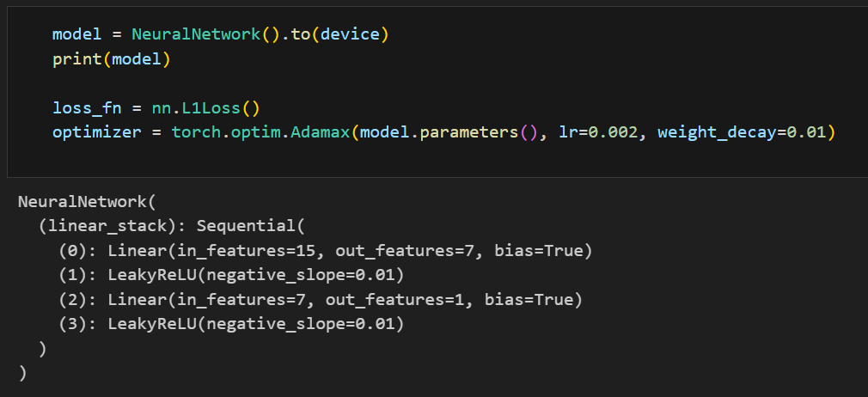
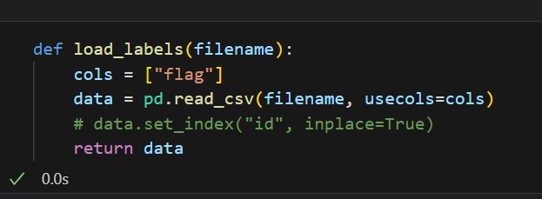
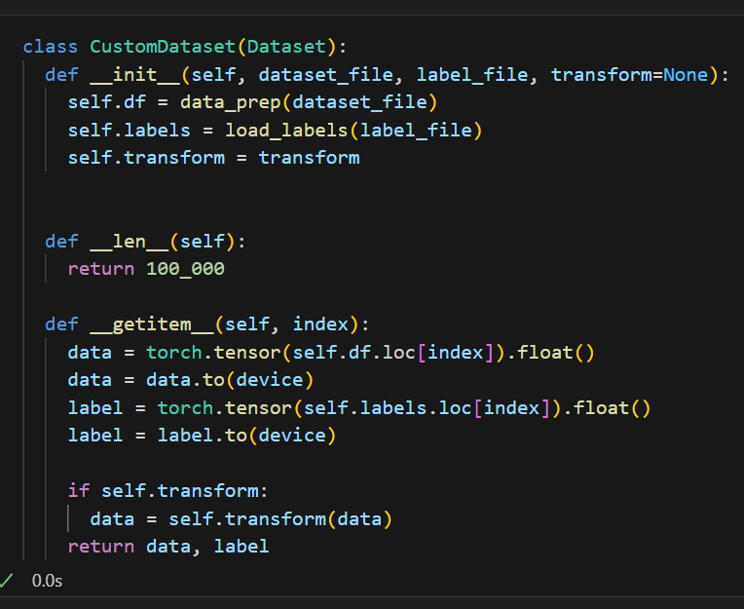
We used the L1 loss function to avoid negative errors zeroing out our total error
We used an Adamax optimiser because it has a weight decay parameter meaning we can look at a smaller sample of the data without greatly increasing the risk of overfitting.
CustomDataset class contains our test data frame, the corresponding results of the data frame and the transformation to get from our input variables to our output variables
Due to our time frame / computational limitations we only used a selection of 100,000 rows from each data frame(instead of all 2 mil). Without these limitations it would the most sense to use all the data in each file.

Slide 4
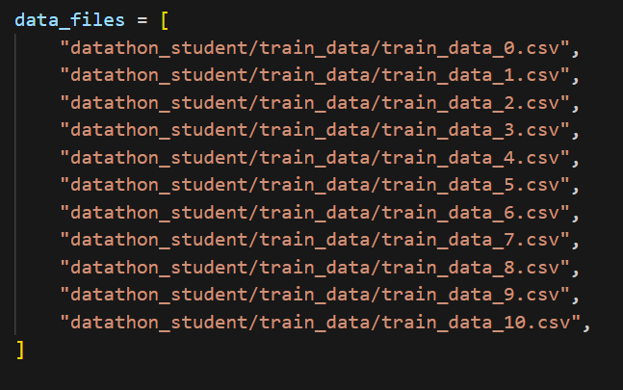
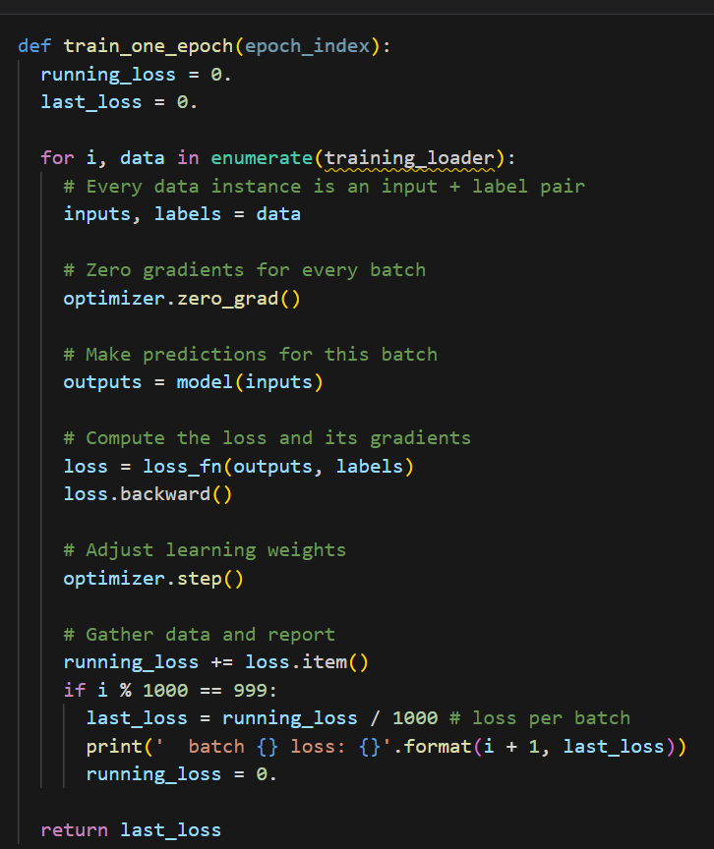
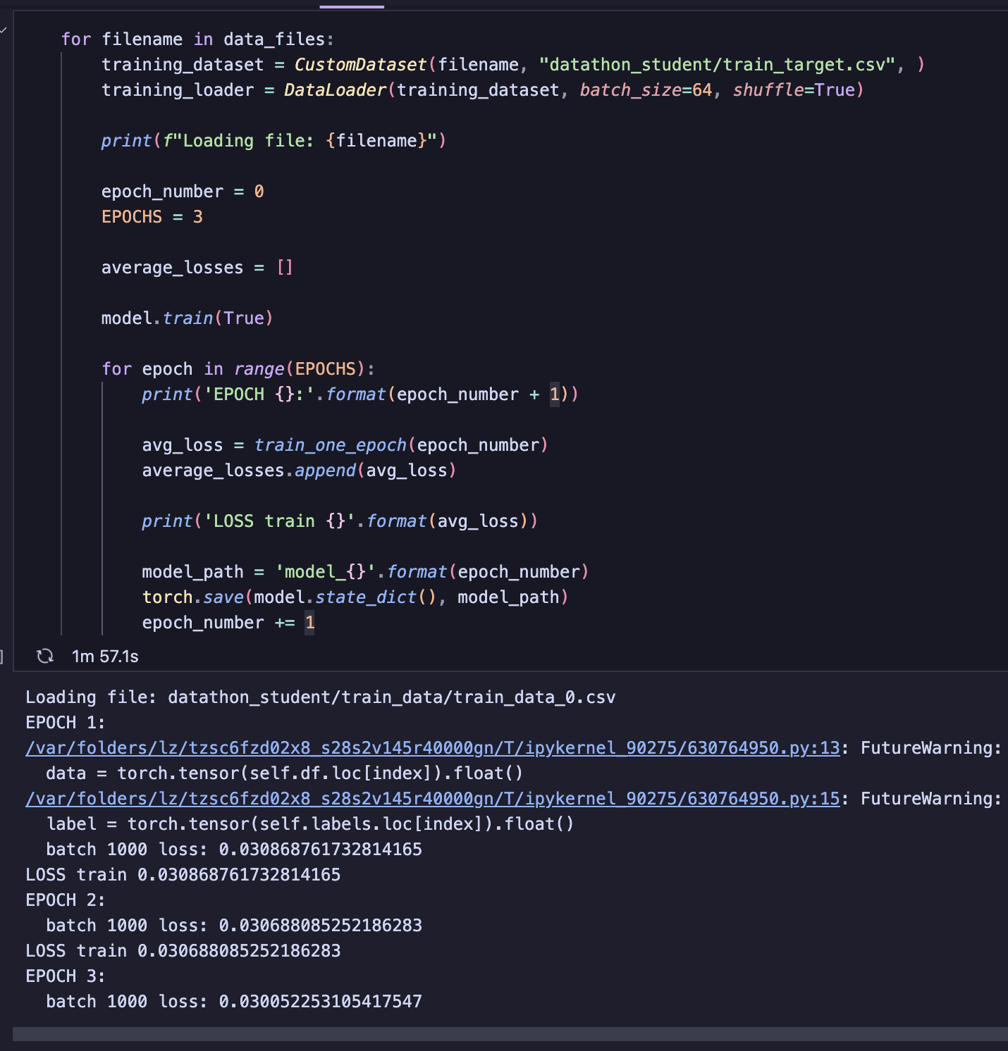
In order to avoid overloading memory, we only looked at 1 file at a time.
We used a batch size of 64 because it was a good middle ground between having a large number of samples without taking too long to run.
For each file we did 3 epochs due to our limited time. After each epoch we saved the model in case we needed to end the training earlier than expected.

Slide 5
Thank you for listening

